Slide 1
Lecture 8
Operating Systems (COMP1562)

Slide 2

Concurrency
Communication
processes
threads
processors
Sharing resources
Synchronization of multiple processes
Allocation of processor time
Mariusz Pelc © 2012/2013
(with support from Dr Kevin Mcand Dr Cos Ierotheou)

Slide 3
Concurrency
Arises in 3 contexts
Multiple applications
multiprogramming
dynamic sharing of processor time between active processes
Structured applications
extension of modular design
applications programmed as a set of concurrent processes or threads
Operating system structure
modular design
set of concurrent processes or threads
Mariusz Pelc © 2012/2013
(with support from Dr Kevin Mcand Dr Cos Ierotheou)

Slide 4
Concurrency
Sharing global resources
two or more processes reading and writing to the same address can cause errors
Management of allocation of resources
assigning resources to a process which becomes suspended can result in deadlock
Programming errors difficult to locate
programs can become non-deterministic and errors may occur very rarely
Mariusz Pelc © 2012/2013
(with support from Dr Kevin Mcand Dr Cos Ierotheou)

Slide 5
A simple example
void echo()
{
chin = getchar();
chout = chin;
putchar(chout);
}
*) echo() reads keyboard and echoes input to the screen
Read character from keyboard
Print character on screen
Mariusz Pelc © 2012/2013
(with support from Dr Kevin Mcand Dr Cos Ierotheou)

Slide 6
A simple example
Consider two processes P1 and P2 which
use echo() concurrently
Process P1 Process P2
. .
chin = getchar(); .
. chin = getchar();
chout = chin; chout = chin;
putchar(chout); .
. putchar(chout);
. .
Mariusz Pelc © 2012/2013
(with support from Dr Kevin Mcand Dr Cos Ierotheou)

Slide 7
A simple example
Whether the example runs on a uniprocessor system or a multi-processor system we have a problem
Race condition
the last process to write to the shared variable wins the race
Mariusz Pelc © 2012/2013
(with support from Dr Kevin Mcand Dr Cos Ierotheou)

Slide 8
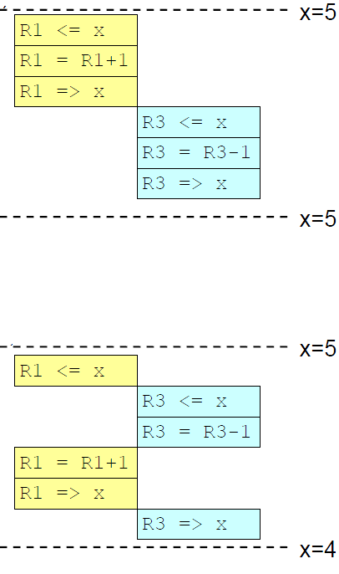
A simple example – race condition
Producer
Consumer
Producer
Consumer
Mariusz Pelc © 2012/2013
(with support from Dr Kevin Mcand Dr Cos Ierotheou)

Slide 9
Competition among processes and resources
Four control problems:
Mutual Exclusion
two or more processes require access to a single non-shareable critical resource
Deadlock
two or more processes cannot proceed because each is waiting for the other to do something
Livelock
is similar to a deadlock, except that the states of the processes involved in the livelock constantly change with regard to one another, but none progressing.
Starvation
a process is able to run but never scheduled
Mariusz Pelc © 2012/2013
(with support from Dr Kevin Mcand Dr Cos Ierotheou)

Slide 10
Process cooperation by sharing
Writing must be mutually exclusive
Critical sections of code are used to provide data integrity
only one program at a time is allowed in it’s critical section
example: only one process at a time is allowed access to the printer
Mariusz Pelc © 2012/2013
(with support from Dr Kevin Mcand Dr Cos Ierotheou)

Slide 11
Process cooperation by communication
Messages are passed
Nothing is shared so mutual exclusion is not a control requirement for cooperation
Possible to have deadlock
Each process waiting for a message from the other process
Possible to have starvation
Two processes sending messages to each other while another process waits for a message
Mariusz Pelc © 2012/2013
(with support from Dr Kevin Mcand Dr Cos Ierotheou)

Slide 12
Mutual exclusion requirements
Enforcement
only one process at a time allowed into its critical section among all processes that have a critical section for the same resource or shared object
A process that halts in its non-critical section must not interfere with other processes
A process requiring access to a critical section must not be delayed indefinitely
no deadlock or starvation
Mariusz Pelc © 2012/2013
(with support from Dr Kevin Mcand Dr Cos Ierotheou)

Slide 13
Mutual exclusion requirements
Access to a process's critical section must not be delayed when no other process is in a critical section
No assumptions are made about relative process speeds or number of processes
A process can remains inside its critical section for a finite time only
Mariusz Pelc © 2012/2013
(with support from Dr Kevin Mcand Dr Cos Ierotheou)

Slide 14
Mutual exclusion
Software approach
single and multiprocessor machines with shared memory (SMP)
Dekker’s algorithm (Dijkstra 1965)
Peterson’s algorithm (1981)
Hardware approach
interrupt disabling
uniprocessor
special machine instructions
multiprocessor
Mariusz Pelc © 2012/2013
(with support from Dr Kevin Mcand Dr Cos Ierotheou)

Slide 15
Mutual exclusion hardware support
Interrupt disabling
A process runs until it invokes an operating-system service or until it is interrupted
Disabling interrupts guarantees mutual exclusion
Processor is limited in its ability to interleave programs
Symmetric Multiprocessing
disabling interrupts on one processor will not guarantee mutual exclusion
Mariusz Pelc © 2012/2013
(with support from Dr Kevin Mcand Dr Cos Ierotheou)

Slide 16
Mutual exclusion hardware support
Special machine instructions
Atomic
performed in a single instruction cycle
Not subject to interference from other instructions
Reading and writing
Reading and testing
Mariusz Pelc © 2012/2013
(with support from Dr Kevin Mcand Dr Cos Ierotheou)

Slide 17
Mutual exclusion machine Instructions
Advantages
Applicable to any number of processes on either a uniprocessor or SMP architecture
Simple and therefore easy to verify
Can be used to support multiple critical sections
Mariusz Pelc © 2012/2013
(with support from Dr Kevin Mcand Dr Cos Ierotheou)

Slide 18
Mutual exclusion machine Instructions
Serious disadvantages
Busy-waiting
processes waiting for access to a critical section consume processor time
Starvation is possible
when a process leaves a critical section and more than one process is waiting.
Deadlock
if a low priority process has the critical section that a higher priority process needs, the higher priority process will obtain the processor to wait for the critical region
Mariusz Pelc © 2012/2013
(with support from Dr Kevin Mcand Dr Cos Ierotheou)

Slide 19
Mutual exclusion machine Instructions
Serious disadvantages
Busy-waiting
processes waiting for access to a critical section consume processor time
Starvation is possible
when a process leaves a critical section and more than one process is waiting.
Deadlock
if a low priority process has the critical section that a higher priority process needs, the higher priority process will obtain the processor to wait for the critical region
Mariusz Pelc © 2012/2013
(with support from Dr Kevin Mcand Dr Cos Ierotheou)

Slide 20
Consumer-producer problem
One or more producers are generating data and placing these in a buffer
A single consumer is taking items out of the buffer one at time
Only one producer or consumer may access the buffer at any one time
Mariusz Pelc © 2012/2013
(with support from Dr Kevin Mcand Dr Cos Ierotheou)

Slide 21
Producer-Consumer problem
shaded area indicated the portion that is occupied
Infinite buffer Producer-Consumer problem
b[1]
b[2]
b[3]
b[4]
b[5]
. . .
out
in
Mariusz Pelc © 2012/2013
(with support from Dr Kevin Mcand Dr Cos Ierotheou)

Slide 22
Consumer-producer problem
// producer:
while (true) {
/* produce item v */
b[in] = v;
in++;
}
Mariusz Pelc © 2012/2013
(with support from Dr Kevin Mcand Dr Cos Ierotheou)

Slide 23
Consumer-producer problem
// consumer:
while (true) {
while ( in <= out )
/* do nothing */;
w = b[out];
out++;
/* consume item w */
}
Mariusz Pelc © 2012/2013
(with support from Dr Kevin Mcand Dr Cos Ierotheou)

Slide 24
Consumer-producer problem
. . .
Finite Circular (Bounded) Buffer for the
Producer-Consumer Problem
b[1]
b[2]
b[3]
b[4]
b[5]
b[n]
out
in
b[1]
b[2]
b[3]
b[4]
b[5]
. . .
b[n]
in
out
Mariusz Pelc © 2012/2013
(with support from Dr Kevin Mcand Dr Cos Ierotheou)

Slide 25
Consumer-producer problem
int main ()
{
pthread_t th_id1,th_id2,th_id3;
//Create a new thread. The new threads will run the
//consumer and producers.
pthread_create (&th_id1, NULL, &producer, NULL); pthread_create (&th_id2, NULL, &producer, NULL); pthread_create (&th_id3, NULL, &consumer, NULL);
// Wait for threads to finish pthread_join(th_id1,NULL); pthread_join(th_id2,NULL); pthread_join(th_id3,NULL);
return 0;
}
Mariusz Pelc © 2012/2013
(with support from Dr Kevin Mcand Dr Cos Ierotheou)

Slide 26
Consumer-producer problem
// producer:
while (true) {
/* produce item v */
while ((in + 1) % n == out)
/* do nothing */;
b[in] = v;
in = (in + 1) % n
}
Mariusz Pelc © 2012/2013
(with support from Dr Kevin Mcand Dr Cos Ierotheou)

Slide 27
Consumer-producer problem
// consumer:
while (true) {
while (in == out)
/* do nothing */;
w = b[out];
out = (out + 1) % n;
/* consume item w */
}
Mariusz Pelc © 2012/2013
(with support from Dr Kevin Mcand Dr Cos Ierotheou)

Slide 28
Consumer-producer problem
m.pelc@grom:~/bin/concurrency$ ./ex3
Producer <3078589360>: write position=143; writing: {196000}
Producer <3078589360>: write position=144; writing: {196100}
Producer <3078589360>: write position=145; writing: {196200}
Producer <3078589360>: write position=146; writing: {196300}
Producer <3078589360>: write position=147; writing: {196400}
Producer <3078589360>: write position=148; writing: {196500}
Producer <3078589360>: write position=149; writing: {196600}
Producer <3078589360>: write position=150; writing: {196700}
Producer <3078589360>: write position=151; writing: {196800}
Producer <3078589360>: write position=152; writing: {196900}
Producer <3078589360>: write position=153; writing: {197000}
Producer <3086977968>: write position=155; writing: {2185}
Producer <3086977968>: write position=155; writing: {2186}
Producer <3086977968>: write position=156; writing: {2187}
Producer <3086977968>: write position=157; writing: {2188}
Producer <3086977968>: write position=158; writing: {2189}
Producer <3086977968>: write position=159; writing: {2190}
Producer <3086977968>: write position=160; writing: {2191}
Producer <3086977968>: write position=161; writing: {2192}
Producer <3086977968>: write position=162; writing: {2193}
write position messed up!!!
Mariusz Pelc © 2012/2013
(with support from Dr Kevin Mcand Dr Cos Ierotheou)

Slide 29
Solutions to the problem of concurency
Semaphores
Dijkstra 1965
Monitors
Hoare 1974
Message passing
information exchange
distributed systems
Mariusz Pelc © 2012/2013
(with support from Dr Kevin Mcand Dr Cos Ierotheou)

Slide 30
Semaphores
Special integer variable called used for signaling
counting semaphore
binary semaphore known as a mutex
If a process is waiting for a signal it is suspended until that signal is sent
Wait and signal operations are atomic
cannot be interrupted
Queue is used to hold processes waiting on the semaphore
avoids busy waits
Mariusz Pelc © 2012/2013
(with support from Dr Kevin Mcand Dr Cos Ierotheou)

Slide 31
Semaphores
Semaphore is a variable that has an integer value
Only 3 operations permitted
Initializing to a nonnegative number
semWait() operation decrements the semaphore value
if the value reaches zero the process calling semWait() is blocked
semSignal() operation increments semaphore value
Mariusz Pelc © 2012/2013
(with support from Dr Kevin Mcand Dr Cos Ierotheou)

Slide 32
Semaphores
POSIX (Portable Operating System Interface) thread definition
Solaris: man semaphore
DESCRIPTION
A semaphore is a non-negative integer count and is generally
used to coordinate access to resources. The initial sema-
phore count is set to the number of free resources, then
threads slowly increment and decrement the count as
resources are added and removed. If the semaphore count
drops to zero, which means no available resources, threads
attempting to decrement the semaphore will block until the
count is greater than zero.
Mariusz Pelc © 2012/2013
(with support from Dr Kevin Mcand Dr Cos Ierotheou)

Slide 33
Semaphores - POSIX
P is wait (decrease), V is signal (increase), Init is to initialise semaphore
Init(Semaphore s, Integer v) {
s = v;
}
P(Semaphore s, integer howmany) {
wait until s >= 0;
s = s - howmany; /* must be atomic operation*/
}
V(Semaphore s, integer howmany) {
s = s + howmany; /* must be atomic */
}
Mariusz Pelc © 2012/2013
(with support from Dr Kevin Mcand Dr Cos Ierotheou)

Slide 34
POSIX Semaphores - example
Bank account example:
A person can withdraw or pay-in money (and check balance)
Debit is not permitted
So withdawal should be synchronized
Mariusz Pelc © 2012/2013
(with support from Dr Kevin Mcand Dr Cos Ierotheou)

Slide 35
POSIX Semaphores - example
void withdraw(int amount)
{
printf("<%d> attempting to withdraw [%d]: \n",pthread_self(),amount);
if (balance >= amount) {
sleep(1);
printf("Success...\n");
balance -= amount;
}
else {
printf("Operation not permitted...\n");
return;
}
}
Mariusz Pelc © 2012/2013
(with support from Dr Kevin Mcand Dr Cos Ierotheou)

Slide 36
POSIX Semaphores - example
struct ACCOUNT
{
int amount;
int operation;
};
void *person(void *arg)
{
struct ACCOUNT *acc = (struct ACCOUNT*)arg;
if (acc->operation == WITHDRAW)
withdraw(acc->amount);
else
pay_in(acc->amount);
check_balance();
}
Mariusz Pelc © 2012/2013
(with support from Dr Kevin Mcand Dr Cos Ierotheou)

Slide 37
POSIX Semaphores - example
//The main program.
int main ()
{
pthread_t th_id1,th_id2;
struct ACCOUNT acc;
pay_in(100);
//Create a new thread.
acc.operation = WITHDRAW;
acc.amount = 100;
pthread_create (&th_id1, NULL, &person,(void*)&acc);
acc.operation = WITHDRAW;
pthread_create (&th_id2, NULL, &person,(void*)&acc);
// Wait for threads to finish
pthread_join(th_id1,NULL);
pthread_join(th_id2,NULL);
return 0;
}
Mariusz Pelc © 2012/2013
(with support from Dr Kevin Mcand Dr Cos Ierotheou)

Slide 38
POSIX Semaphores - example
m.pelc@grom:~/bin/concurrency$ ./ex4
<-1207989328> attempting to withdraw [100]:
<-1216377936> attempting to withdraw [100]:
Success...
Your current balance is: <0>
Success...
Your current balance is: <-100>
m.pelc@grom:~/bin/concurrency$
The operation was not synchronized so we have a debit
Mariusz Pelc © 2012/2013
(with support from Dr Kevin Mcand Dr Cos Ierotheou)

Slide 39
POSIX Semaphores - example
//The main program.
int main ()
{
pthread_t th_id1,th_id2;
struct ACCOUNT acc;
pay_in(100);
//Initialize semaphore
if (sem_init(&semaphore, 0, SEM_INIT_VALUE) < 0) { //Init operation
printf("Semaphore initialization problem...\n");
exit(1);
}
//Create a new thread.
acc.operation = WITHDRAW; acc.amount = 100;
pthread_create (&th_id1, NULL, &person,(void*)&acc);
pthread_create (&th_id2, NULL, &person,(void*)&acc);
// Wait for threads to finish
pthread_join(th_id1,NULL);
pthread_join(th_id2,NULL);
return 0;
}
Mariusz Pelc © 2012/2013
(with support from Dr Kevin Mcand Dr Cos Ierotheou)

Slide 40
POSIX Semaphores - example
void withdraw(int amount)
{
printf("<%d> attempting to withdraw [%d]: \n",pthread_self(),amount);
sem_wait(&semaphore); //P operation
if (balance >= amount) {
sleep(1);
printf("Success...\n");
balance -= amount;
}
else
printf("Operation not permitted...\n");
sem_post(&semaphore); //V operation
}
Mariusz Pelc © 2012/2013
(with support from Dr Kevin Mcand Dr Cos Ierotheou)

Slide 41
POSIX Semaphores - example
m.pelc@grom:~/bin/concurrency$ ./ex5
<-1207989328> attempting to withdraw [100]:
<-1216377936> attempting to withdraw [100]:
Success...
Your current balance is: <0>
Operation not permitted...
Your current balance is: <0>
m.pelc@grom:~/bin/concurrency$
The operation was synchronized so we have no debit
Mariusz Pelc © 2012/2013
(with support from Dr Kevin Mcand Dr Cos Ierotheou)

Slide 42
Monitors
Monitor is a programming language construct / library
Tony Hoare 1974, Lampson and Redell 1980
Provides easier control than semaphores
Local variables are accessible only by the monitor
Process enters a monitor by invoking one of its procedures
Only one process may be executing in the monitor at a time
Java synchronized
Mariusz Pelc © 2012/2013
(with support from Dr Kevin Mcand Dr Cos Ierotheou)

Slide 43
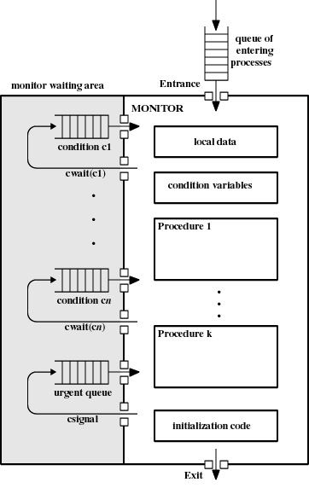
Monitors - structure
Mariusz Pelc © 2012/2013
(with support from Dr Kevin Mcand Dr Cos Ierotheou)

Slide 44
Message passing
Explicit inter-process and inter-processor communication
Exchange information
Synchronization
Enforce mutual exclusion
send (destination, message)
receive (source, message)
Mariusz Pelc © 2012/2013
(with support from Dr Kevin Mcand Dr Cos Ierotheou)

Slide 45
Message synchronization
Sender and receiver may or may not be blocking (waiting for message)
Blocking send, blocking receive
Both processes blocked until message delivered
Called a rendezvous
Nonblocking send, blocking receive
Sender continues processing
Receiver is blocked until message arrives
Nonblocking send, nonblocking receive
Neither party is required to wait
Mariusz Pelc © 2012/2013
(with support from Dr Kevin Mcand Dr Cos Ierotheou)

Slide 46
Message addressing
Direct addressing
send primitive includes a specific identifier of the destination process
receive primitive could know ahead of time from which process a message is expected
receive primitive could use source parameter to return a value when the receive operation has completed
Mariusz Pelc © 2012/2013
(with support from Dr Kevin Mcand Dr Cos Ierotheou)

Slide 47
Message addressing
Indirect addressing
messages are sent to a shared data structure consisting of queues
queues are called mailboxes
one process sends a message to the mailbox and the other process picks up the message from the mailbox
Mariusz Pelc © 2012/2013
(with support from Dr Kevin Mcand Dr Cos Ierotheou)

Slide 48
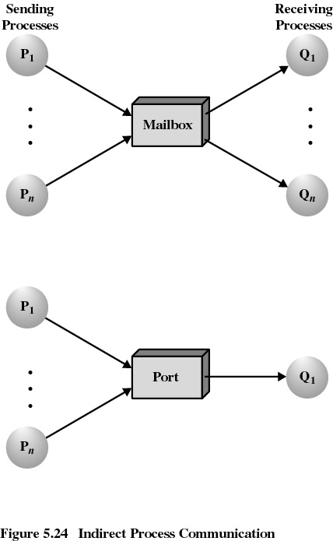
Message addressing
many to many
many to one
Mariusz Pelc © 2012/2013
(with support from Dr Kevin Mcand Dr Cos Ierotheou)

Slide 49
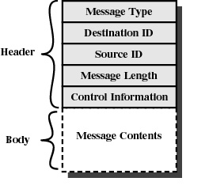
Message addressing
Mariusz Pelc © 2012/2013
(with support from Dr Kevin Mcand Dr Cos Ierotheou)

